Slide 1
QUICKFEED
TEAM 3:
PROJECT MANAGER- LAKSHMI BHAVANI
TEAM MEMBERS- NITESH JOSHI, AKSHAY SEN, SAISATHVIK, SAGARIKA, SAYALI, SHUBHAM, ROHIT

Slide 2
Github URL:
NKJ8/quickfeedApp: QuickFeed App Repository

Slide 3
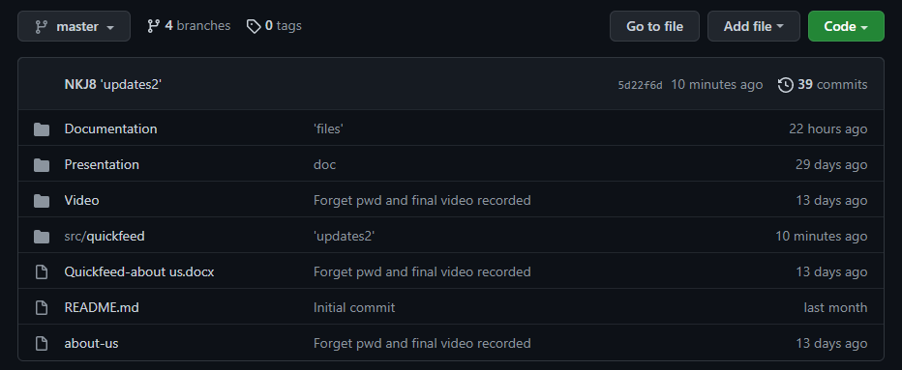
Repository Structure

Slide 4
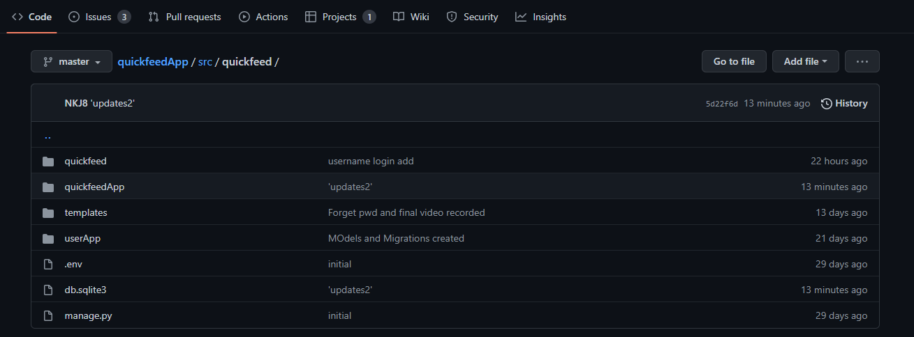

Slide 5
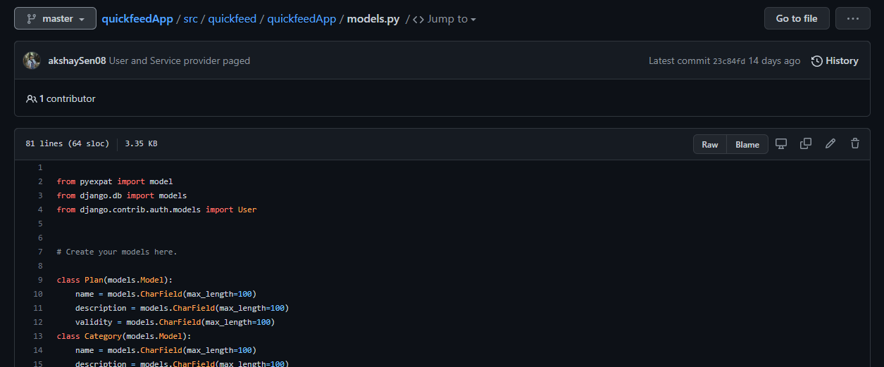
Application Models

Slide 6
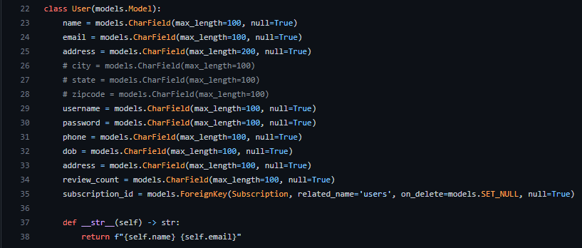

Slide 7
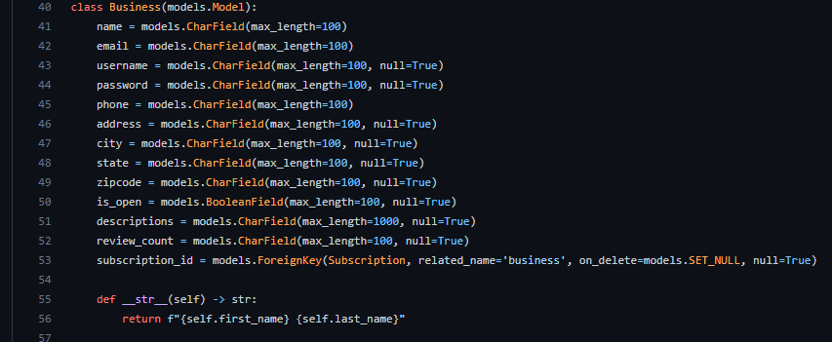

Slide 8
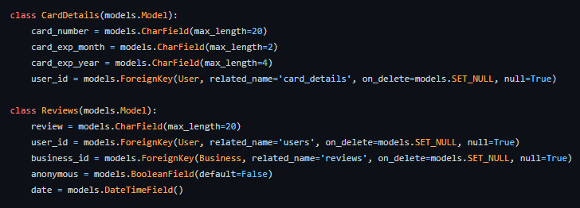

Slide 9
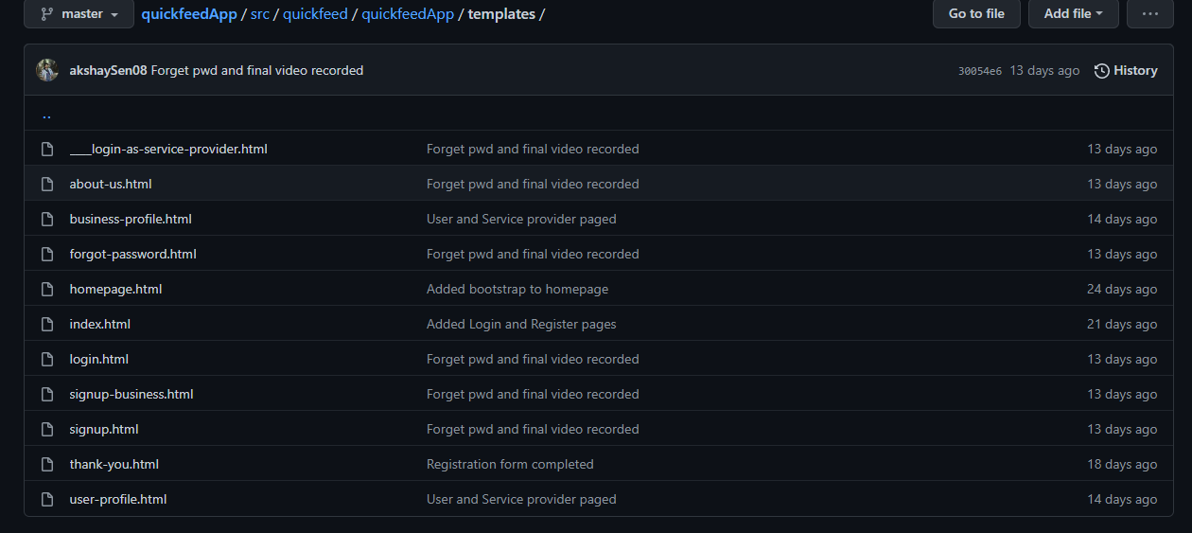
Application Views

Slide 10
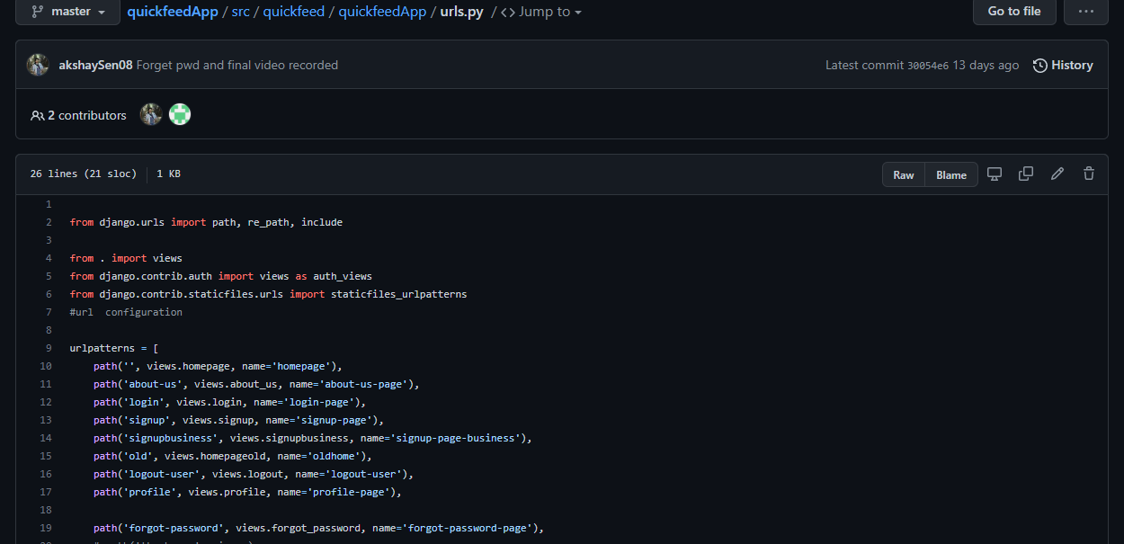
Application URLs

Slide 11
THANK YOU

